Slide 1
SWENG3106
Operating Systems
Software Engineering Department
AASTU

Slide 2
Chapter One
Introduction

Slide 3
Objectives
At the end of this chapter you should be able to:
  Define operating system
  Explain services provided by operating system
  Describe evolution of operating system
  Describe various types of operating systems and their services
  Understand the structure of operating system

Slide 4
Outline
Definition of an Operating System
History of Operating Systems
Operating System Services
Types of Operating Systems
Operating System Structure

Slide 5
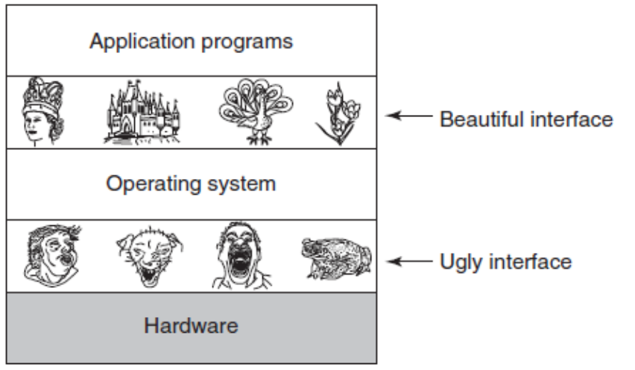
What is an Operating System?
A program that acts as an intermediary between a user of a computer and the computer hardware.
  It is an extended machine
    Hides the messy details which must be performed
    Presents user with a virtual machine, easier to use
  It is a resource manager
    Each program gets time with the resource
    Each program gets space on the resource

Slide 6
Computer System Components
1. Hardware – provides basic computing resources (CPU, memory, I/O devices).
2. Operating system – controls and coordinates the use of the hardware among the various application programs for the various users.
3. Applications programs – define the ways in which the system resources are used to solve the computing problems of the users (database systems, video games, business programs).
4. Users (people, machines, other computers).

Slide 7

Computer System Components(cont’d)

Slide 8
Operating System Objectives
Convenience – Top Down View – Virtual Machine
  Extending the real hardware and acting as a Virtual Machine
  Hiding the truth about the hardware from the user
  Providing the user a convenient interface which is easier to program
Efficiency – Bottom Up View – Resource Manager
  Providing an orderly and controlled allocation of resources
  Improving resource utilization
Ability to Evolve
  Permit effective development, testing, and introduction of new system functions without interfering with existing services
Protection
  allow only authorised access to data, computation, services, etc.

Slide 9
Operating System Services
A) Process Management
  A process is a program in execution. A process needs certain resources, including CPU time, memory, files, and I/O devices, to accomplish its task.
  Process is active entity, while program is passive entity
  The operating system is responsible for the following activities in connection with process management:
    Process creation and deletion.
    process suspension and resumption.
    Provision of mechanisms for:
      process synchronization
      process communication

Slide 10
Operating System Services(cont’d)
B) Memory Management
  The operating system is responsible for the following activities in connections with memory management:
    Keep track of which parts of memory are currently being used and by whom.
    Decide which processes to load when memory space becomes available.
    Allocate and deallocate memory space as needed.
C) File Management
  A file is a collection of related information defined by its creator.
  Responsibility of operating system includes:
    File creation and deletion.
    Directory creation and deletion.
    Mapping files onto secondary storage.
    File backup on stable (nonvolatile) storage media.

Slide 11
Operating System Services(cont’d)
D) Secondary-Storage Management
  The operating system is responsible for the following activities in connection with disk management:
    Free space management
    Storage allocation
    Disk scheduling
E) I/O Management
  since user programs cannot execute I/O operations directly, the operating system must provide some means to perform I/O.
F) Protection System
  Protection refers to a mechanism for controlling access by programs, processes, or users to both system and user resources.
  The protection mechanism must:
    distinguish between authorized and unauthorized usage.
    specify the controls to be imposed.
    provide a means of enforcement.

Slide 12

A View of Operating System Services

Slide 13
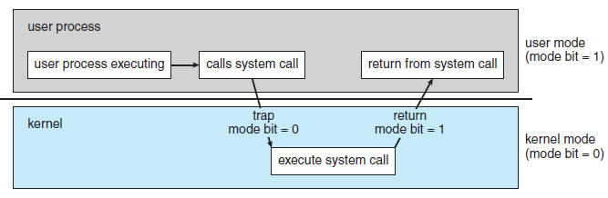
Modes of Operation
Dual-mode operation allows OS to protect itself and other system components
  User mode: when the computer system is executing on behalf of a user application.
  Kernel/privileged/supervisor/system mode: OS gains control of the computer.
    At system boot time, the hardware starts in kernel mode. The operating system is then loaded and starts user applications in user mode.
Dual mode provides protection. How?
  The hardware allows privileged instructions- instructions that causes harm (E.g. instruction to switch to kernel mode, I/O control, timer management) to be executed only in kernel mode.

Slide 14
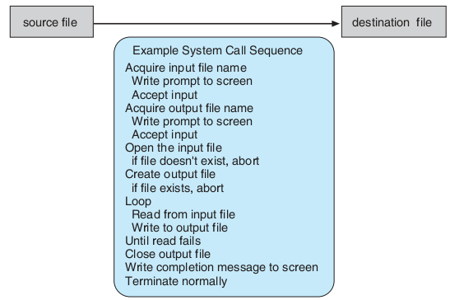
System Calls
System calls provide an interface to the services made available by an operating system
System calls mostly accessed by programs via a high-level Application Programming Interface (API) rather than direct system call use
  E.g. how system calls are used: a program to read data from one file and copy them to another file

Slide 15

System Calls(cont’d)
Three most common APIs available to application programmers are:
  Windows API for Windows,
  POSIX API(for UNIX, Linux, and Mac OS X), and
  Java API for the Java virtual machine
API – System Call – OS Relationship

Slide 16

Standard C Library Example
C program invoking printf() statement, the C library intercepts this call and invokes write() system call. The C library takes the value returned by write() and passes it back to the user program.
Read about system call parameter passing

Slide 17

Examples of Windows and Unix System Calls

Slide 18
Operating System Structure
General-purpose OS is very large program, therefore need to be structured well.
  Partition the task into small components, or modules.
Various ways:
  Simple structure (monolithic)
  Layered
  Microkernel
  Module
  Hybrid

Slide 19

Monolithic/Simple Structure -- MS-DOS
Do not have well-defined structures
  has no distinction between user and kernel modes, allowing all programs direct access to the underlying hardware
Advantage
  Having the operating system in a single address space provides very efficient performance
Disadvantage
  Difficult to maintain
  Base hardware is accessible by application programs: vulnerable to malicious programs.
MS-DOS is one example
  written to provide the most functionality in the least space
  Although MS-DOS has some structure, its interfaces and levels of functionality are not well separated

Slide 20

Layered Approach
The operating system is divided into a number of layers (levels), each built on top of lower layers.
The bottom layer (layer 0), is the hardware; the highest (layer N) is the user interface.
Each layer provides a different type of functionality.
With modularity, layers are selected such that each uses functions (operations) and services of only lower-level layers
Advantage
  Easy for debugging
Disadvantage
  Difficult to define the various layers
    Layer can use only lower-level layers, careful planning is necessary.
  Less efficient than other types
    Each layer adds overhead to the system call

Slide 21
Microkernel System Structure
Structures the operating system by removing all nonessential components from the kernel and implementing them in user space.
Communication takes place between user modules using message passing
E.g. Mac OS X kernel (Darwin) partly based on Mach
Benefits:
  Easier to extend a microkernel
    new services are added to user space, do not require modification of the kernel
  Easier to port the operating system to new architectures
    Requires fewer modification
  More reliable and secure (less code is running in kernel mode)
Detriments:
  Performance overhead of user space to kernel space communication

Slide 22

Microkernel System Structure

Slide 23
Modules
Many modern operating systems implement loadable kernel modules: the kernel has a set of core components and links in additional services via modules
  Each core component is separate
  Each talks to the others over known interfaces
  Each is loadable as needed within the kernel
Overall, similar to layers but with more flexible- because any module can call any other module
  Linux, Solaris, etc.
Advantage and Disadvantage?

Slide 24

Solaris Modular Approach

Slide 25
Hybrid Systems
Most modern operating systems are actually not one pure model
  Hybrid combines multiple approaches to address performance, security, and usability issues
Linux and Solaris are monolithic(for performance reasons) in kernel address space, plus modular for dynamic loading of functionality
Windows mostly monolithic, has behavior of microkernel, and also provide support for dynamically loadable kernel modules
Apple Mac OS X uses hybrid structure, a layered system :
  Top layer: Aqua- GUI; Cocoa programming environment
  Below is kernel consisting of:
    Mach microkernel: for memory management, RPCs and IPC
    BSD Unix component: for networking and file systems
    I/O kit: for development of device drivers
    dynamically loadable modules (called kernel extensions)

Slide 26
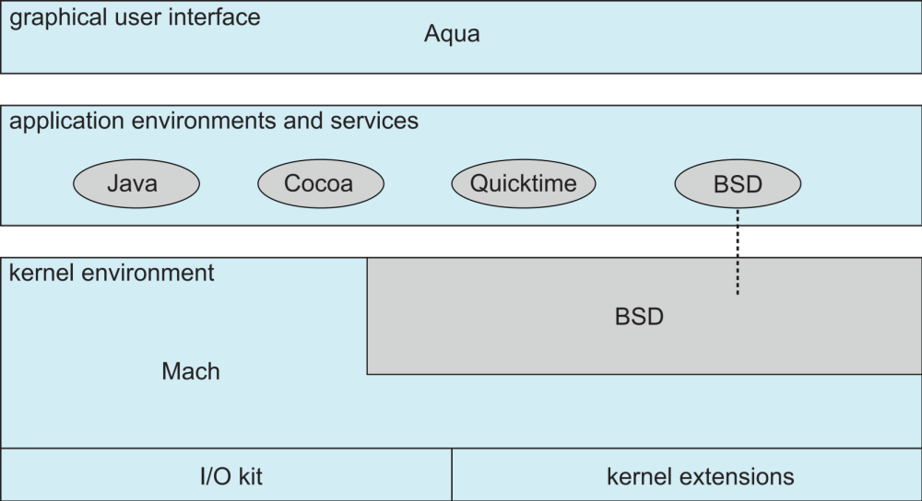
Mac OS X Structure

Slide 27
Reading Assignments
A. History of operating systems
B. Types of operating systems.
  Mainframe operating systems
  Distributed operating systems
  Personal computer operating systems
  Real-time operating systems
  Embedded operating systems

